Slide 1
Spring Security Overview

Slide 2
You will learn how to …
Secure Spring MVC Web Apps
Develop login pages (default and custom)
Define users and roles with simple authentication
Protect URLs based on role
Use JSP tags to hide/show content based on role
Store users, passwords and roles in DB (plain-text -> encrypted)
www.luv2code.com

Slide 3

Practical Results
•
Cover the most common Spring Security tasks that you will need on daily projects
•
Not an A to Z reference … for that you can see Spring Security Reference Manual
http://www.luv2code.com/spring-security-reference-manual
www.luv2code.com

Slide 4
Spring Security Model
•
Spring Security defines a framework for security
•
Implemented using Servlet filters in the background
•
Two methods of securing a Web app: declarative and programmatic
www.luv2code.com

Slide 5
Spring Security with Servlet Filters
•
Servlet Filters are used to pre-process / post-process web requests
•
Servlet Filters can route web requests based on security logic
•
Spring provides a bulk of security functionality with servlet filters
www.luv2code.com

Slide 6






Spring Security Overview
/mytopsecretstuff
Protected Web Resource
Spring Security Filters
Web Browser
my app security configuration
users passwords roles
www.luv2code.com

Slide 7


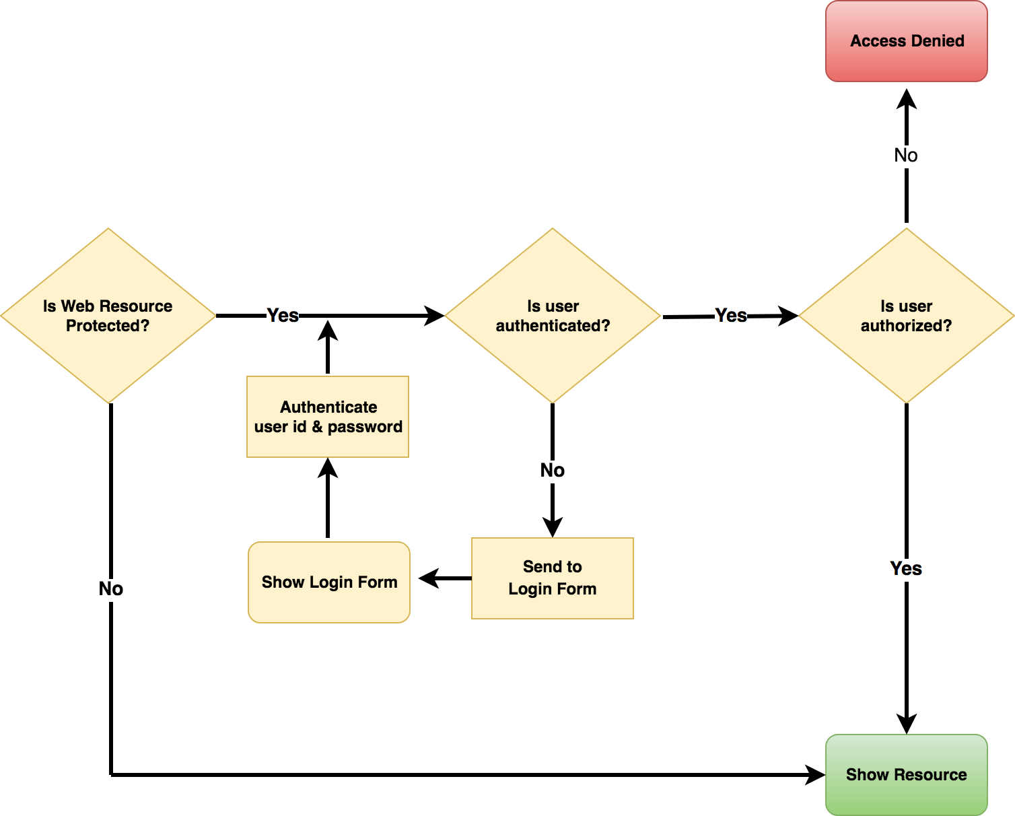



Spring Security in ActioDones user have
authorized role?
Spring Security Filters
Check if user id and password are valid
www.luv2code.com

Slide 8
Security Concepts
•
Authentication
•
Check user id and password with credentials stored in app / db
•
Authorization
•
Check to see if user has an authorized role
www.luv2code.com

Slide 9
Declarative Security
•
Define application’s security constraints in configuration
All Java config (@Configuration, no xml)
or Spring XML config
•
Provides separation of concerns between application code and security
www.luv2code.com

Slide 10
Programmatic Security
•
Spring Security provides an API for custom application coding
•
Provides greater customization for specific app requirements
www.luv2code.com

Slide 11
Different Login Methods
HTTP Basic Authentication
•
Default login form
•
Spring Security provides a default login form
•
Custom login form
•
your own look-and-feel, HTML + CSS
www.luv2code.com

Slide 12
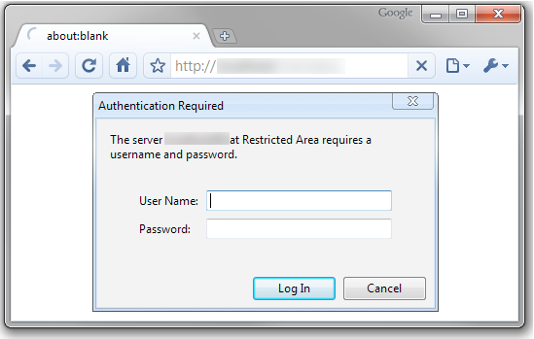

HTTP Basic Authentication
Built-in Dialog from browser
bleh!
www.luv2code.com

Slide 13
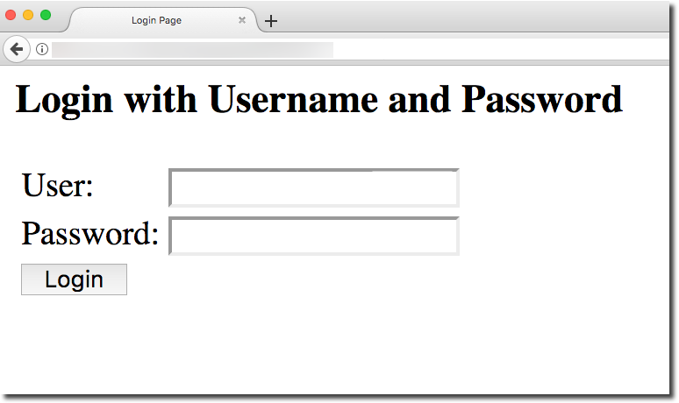

Spring Security - Default Login Form
Good for quick start
www.luv2code.com

Slide 14
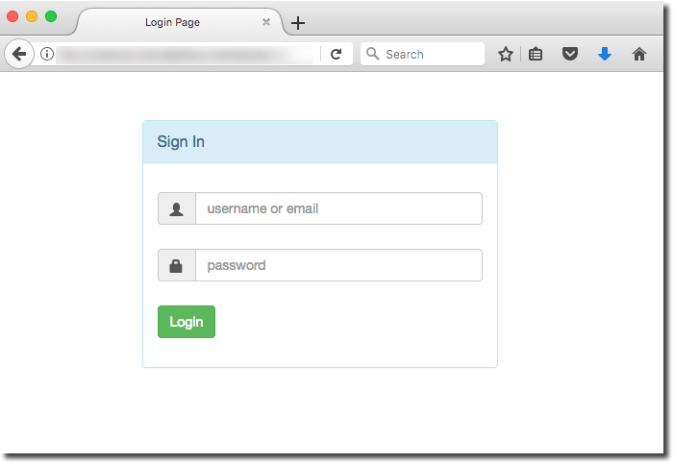

Your Own Custom Login Form
Your own custom look-and-feel HTML + CSS
www.luv2code.com

Slide 15


Authentication and Authorization
In-memory
JDBC
LDAP
Custom / Pluggable
others …
users passwords roles
We will cover password storage in DB as plain-text AND encrypted
www.luv2code.com

Slide 16
Spring Security Demo

Slide 17
Recap of our Game Plan
Secure Spring MVC Web Apps
Develop login pages (default and custom)
Define users and roles with simple authentication
Protect URLs based on role
Use JSP tags to hide/show content based on role
Store users, passwords and roles in DB (plain-text -> encrypted)
www.luv2code.com

Slide 18



Our Example
/leaders
Leadership Retreat Page
/
role: MANAGER
Home Page
role: EMPLOYEE
/systems
Admin Holiday Cruise
role: ADMIN
www.luv2code.com

